Slide 1
Cédric Pruski, Marcos Da Silveira et al.
Data Visualisation Workshop
Luxembourg, April 24th 2018
DyKOSMap : a tool to manage ontology alignment dynamics

Slide 2
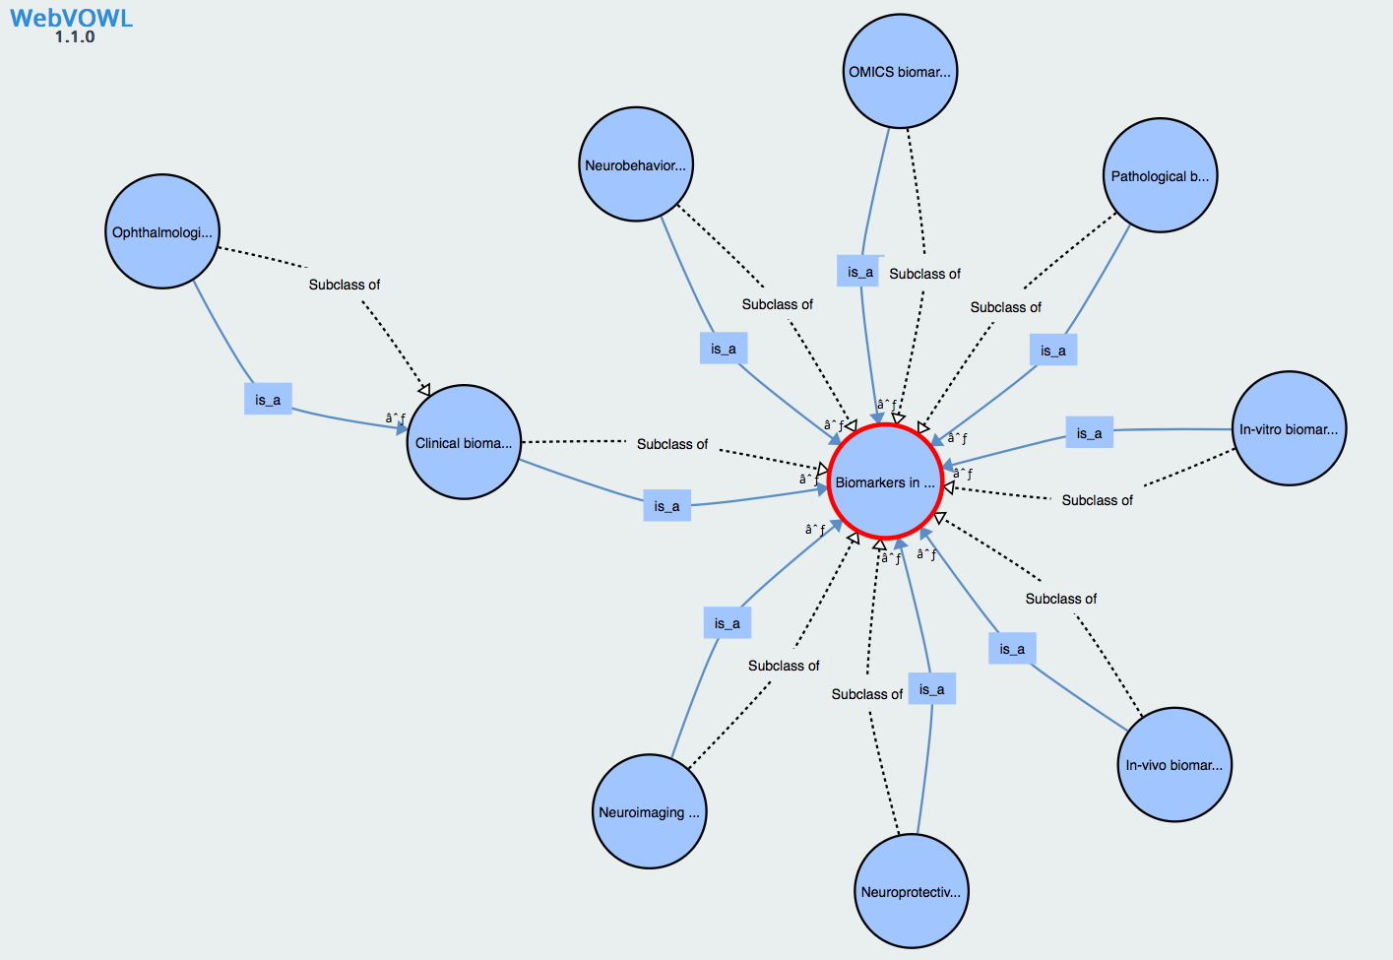
introduction
What are ontologies and ontology mappings?
Conceptual models aiming at representing domain knowledge
Usually represented as directed graphs where nodes are concepts and arcs are relationships between concepts

Slide 3
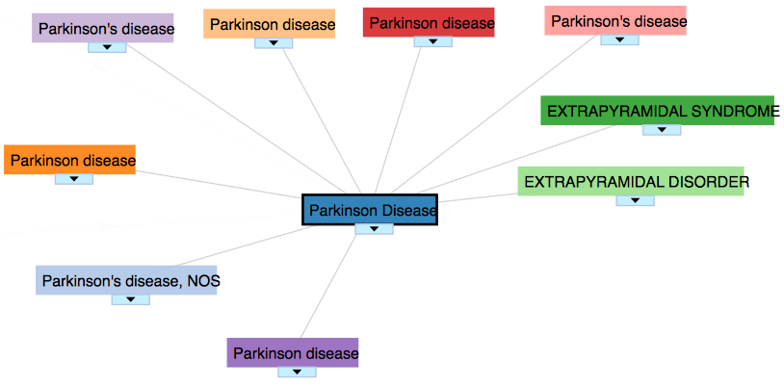
introduction
What are ontologies and ontology mappings?
Domain are often really big (e.g. medicine, agronomy, geography …)
Impossible to have one ontology to represent the entire domain
  Subdomains are considered and represented using ontologies
  Links between these sub-ontologies are created and called mappings
Ex:

Slide 4
introduction
Ontologies are dynamic objects
By virtue of knowledge evolution, ontologies have to evolve accordingly
Changes at ontology level may impact existing mappings
Need for concepts and tools to automatically adapt mappings according to KOS changes without recomputing the whole set of mappings in order to save validation time done by experts

Slide 5




introduction
Our problematic
Outdated mappings may trigger undesirable results in information systems
  Crucial to maintain mappings valid
?
O_{S}
O_{T}
?
=
_{Malignant neoplasm}
_{malignancy}
_{Malignant neoplasm}
data
_{data}
malignancy
  Large size and complexity
  Prevents a complete manual maintenance
_{inaccessible}
malignancy

Slide 6



dykosmap
The approach for adapting mappings
O_{S} ⁰
out-dated
mappings
Ontology changes
M_{ST} ⁰
O_{S}¹
Ontology Diff
Mapping
interpretation
          Avoid applying complete ontology realignment
relevant
attributes
+
semantic
relation
Mapping adaptation
decisions on
adaptation actions
          Promote reuse of mappings unaffected by ontology changes
up-to-date
mappings
DyKOSMap framework
M_{updated}

Slide 7
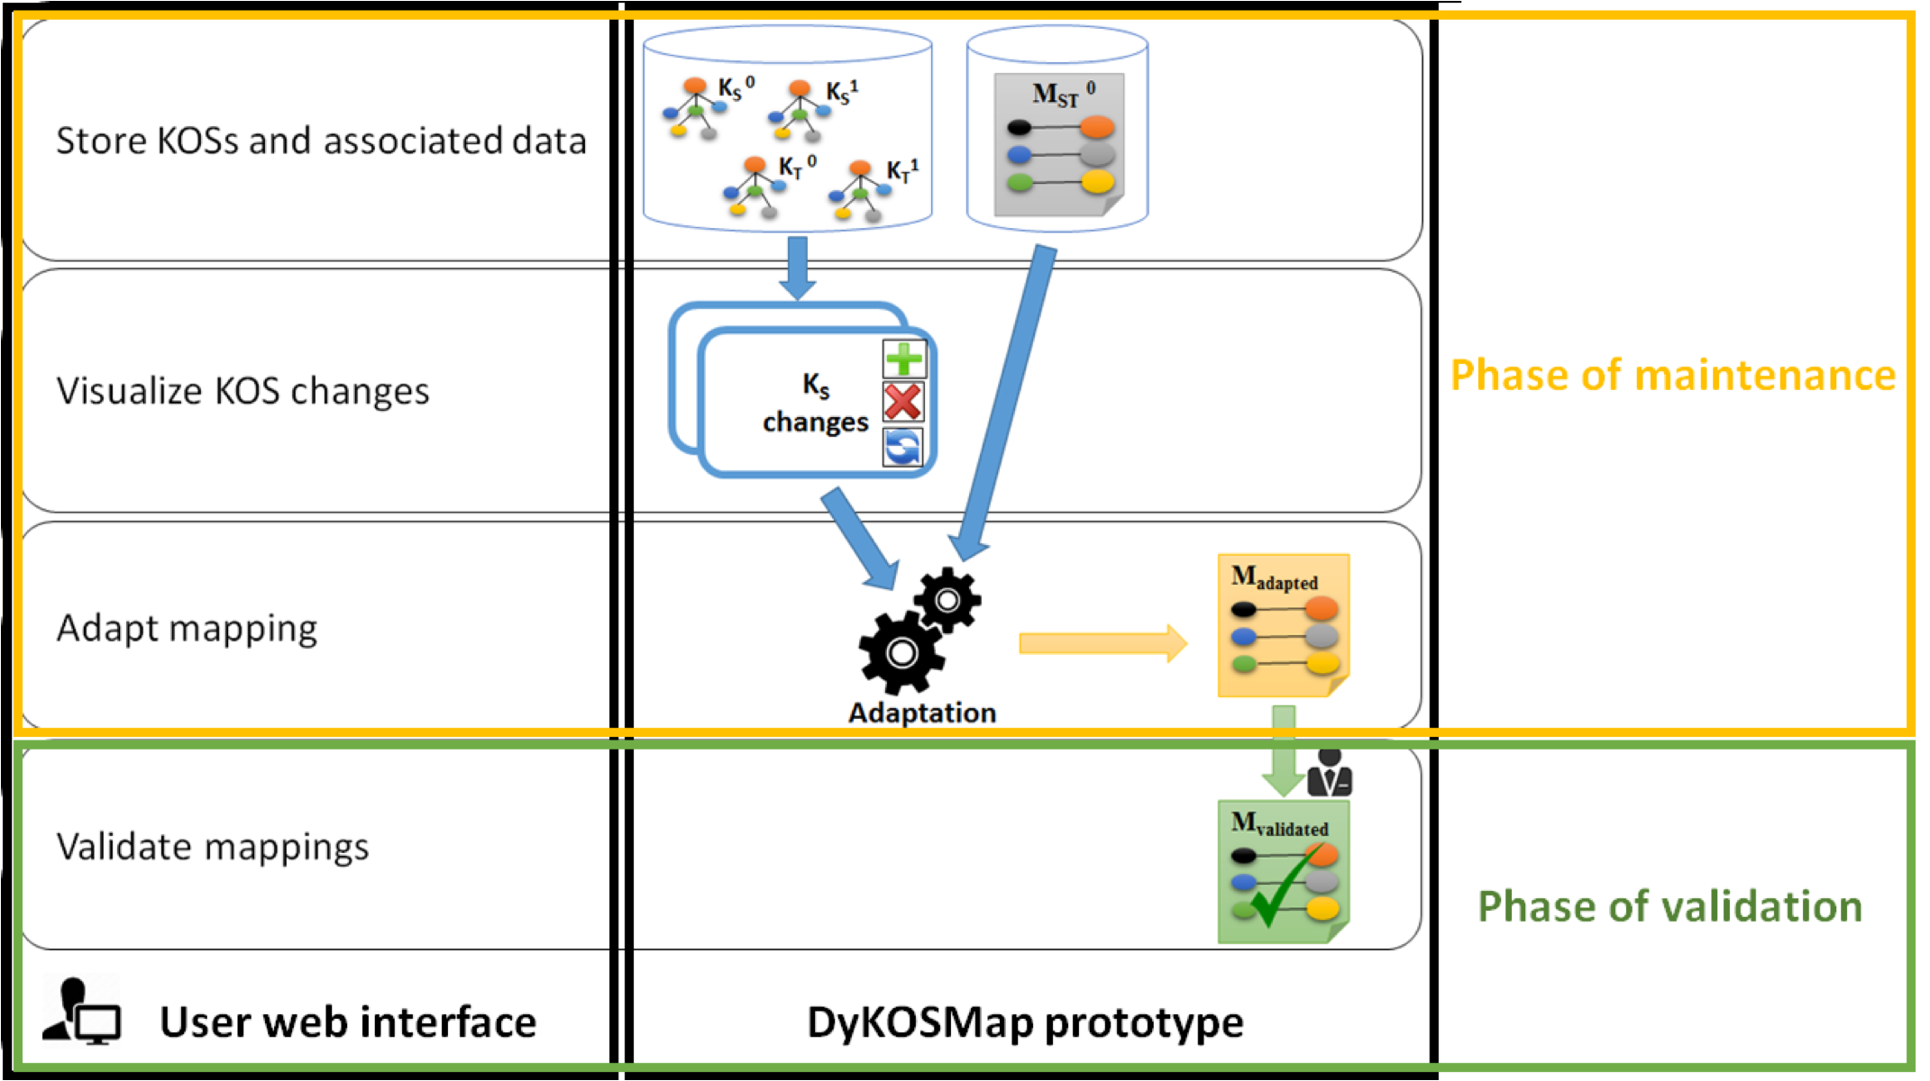
dykosmap
Tool functionalities

Slide 8
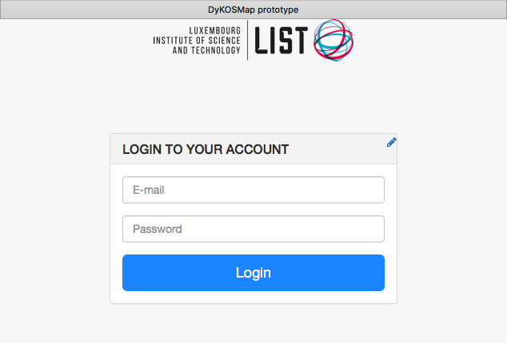
demo

Slide 9
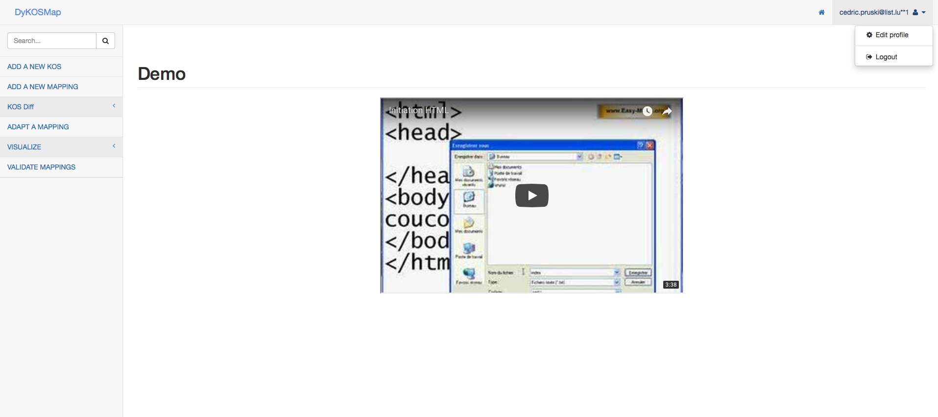
Welcome menu

Slide 10
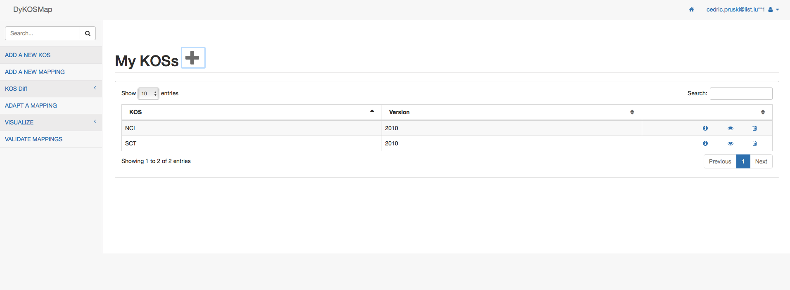
Add a new kos

Slide 11
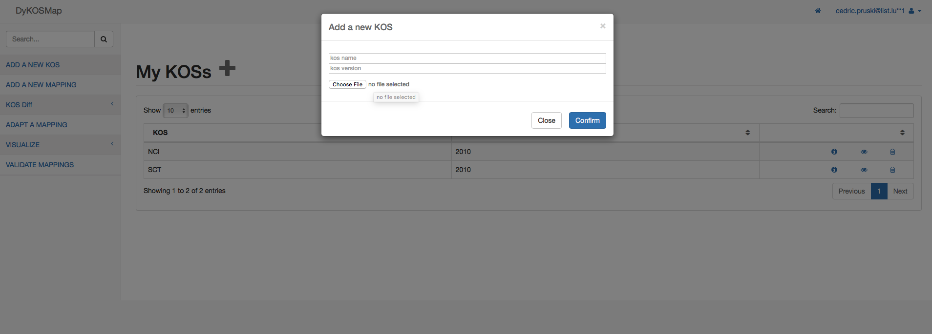
Add a new kos

Slide 12
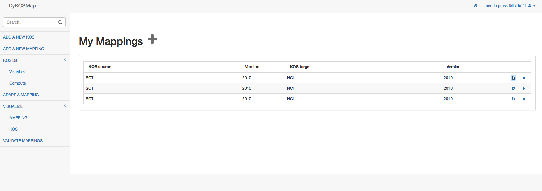
Add a new mapping

Slide 13
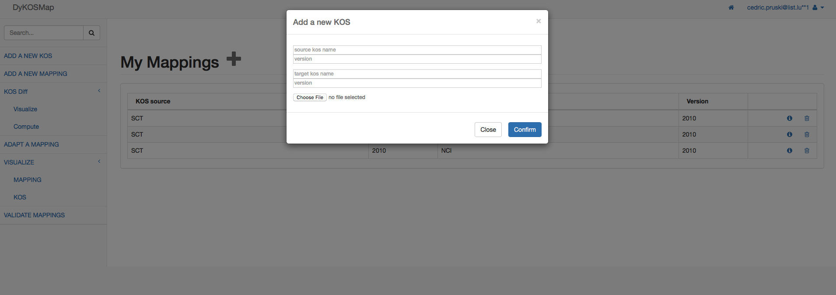
Add a new mapping

Slide 14
dykosmap
Tool functionalities

Slide 15
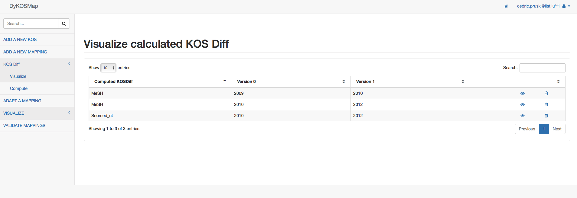
KOS diff
Visualize

Slide 16
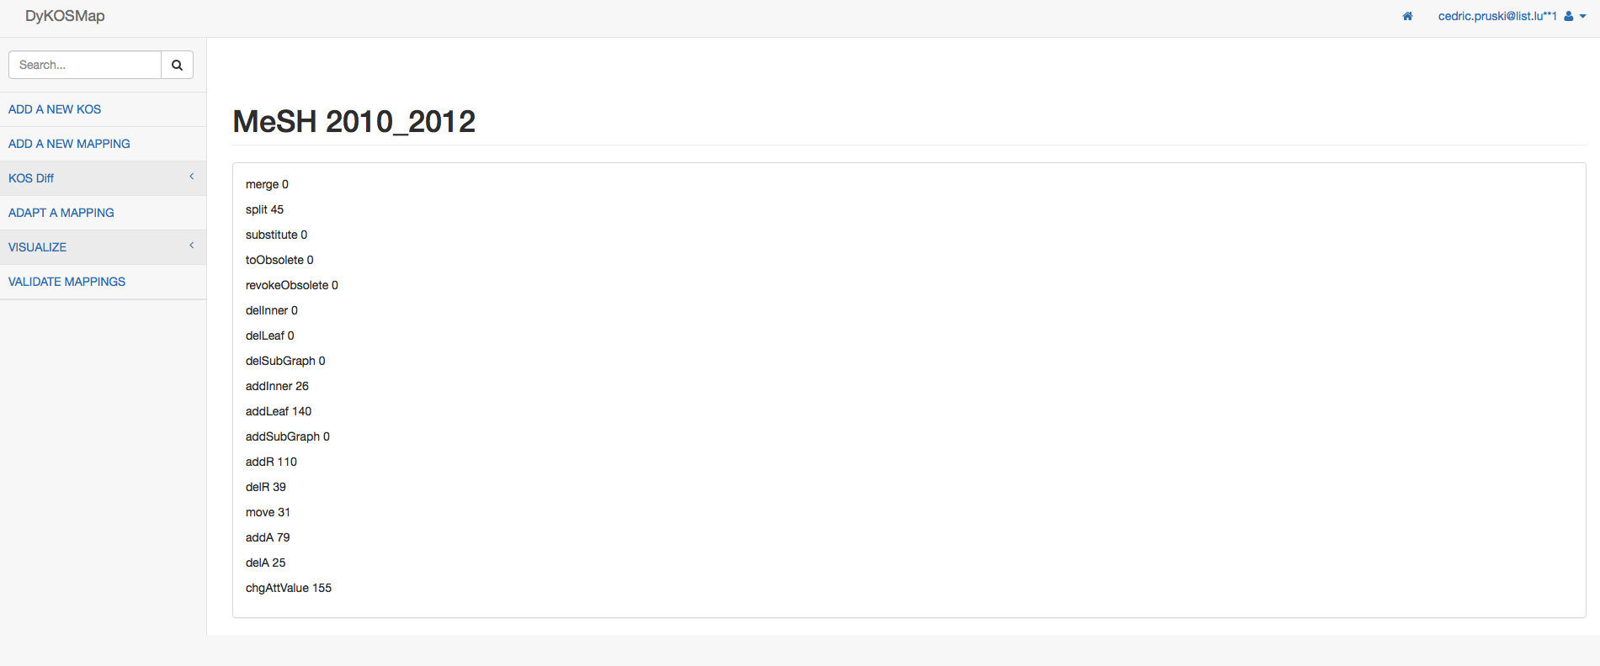
Kos diff
Visualize

Slide 17
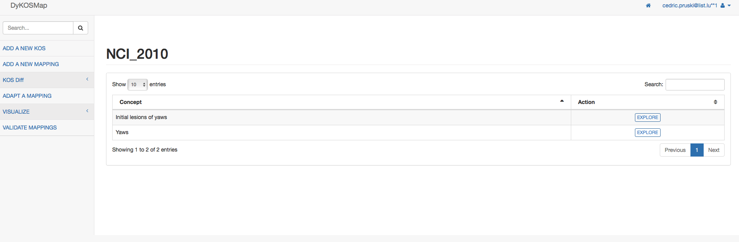
KOS content
Visualize

Slide 18
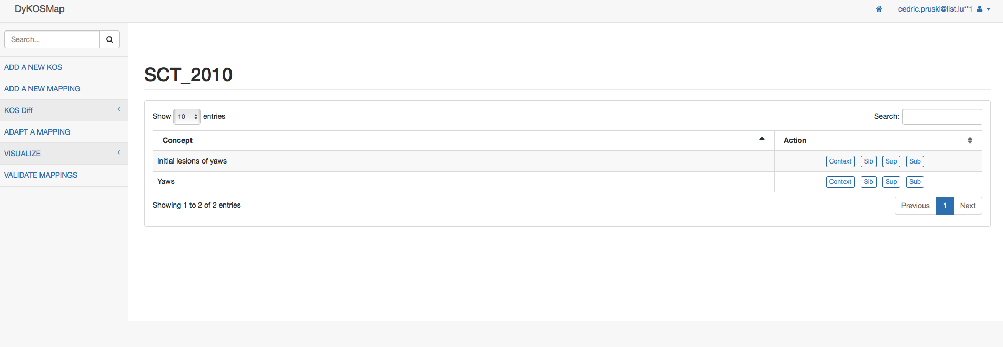
KOS concept context
Visualize

Slide 19
visualize mapping

Slide 20
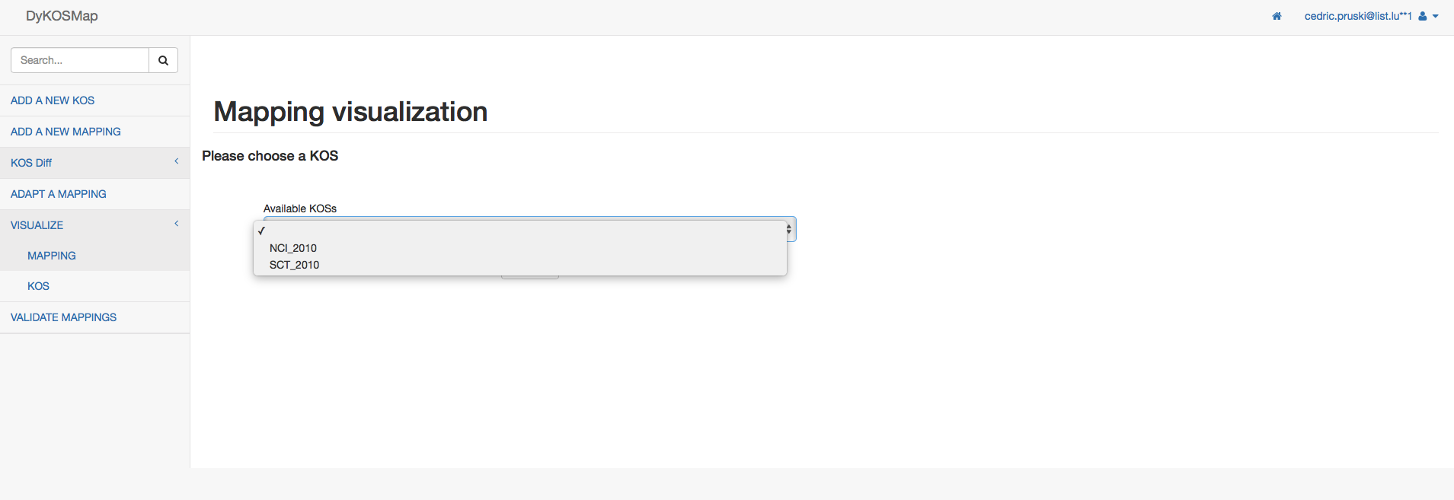
Visualize mapping

Slide 21
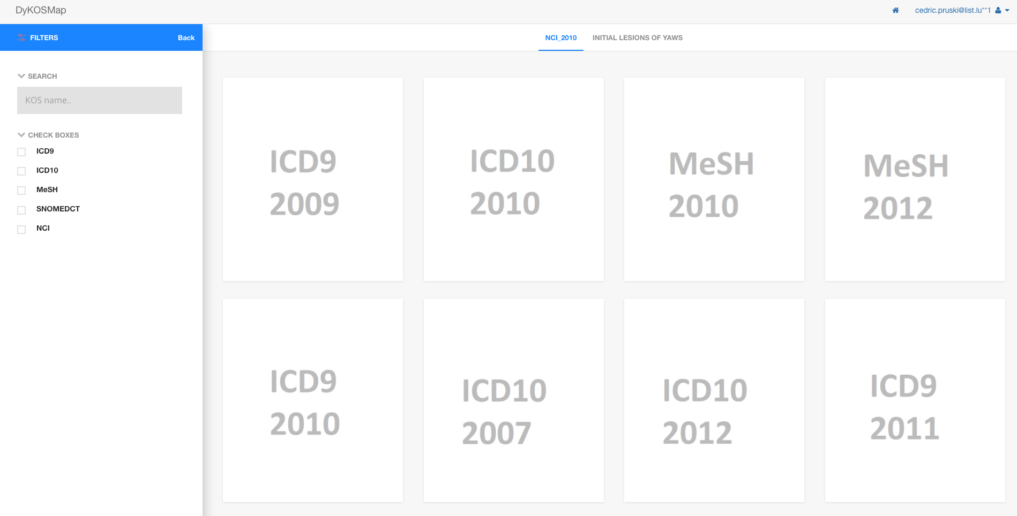
Visualize mapping

Slide 22
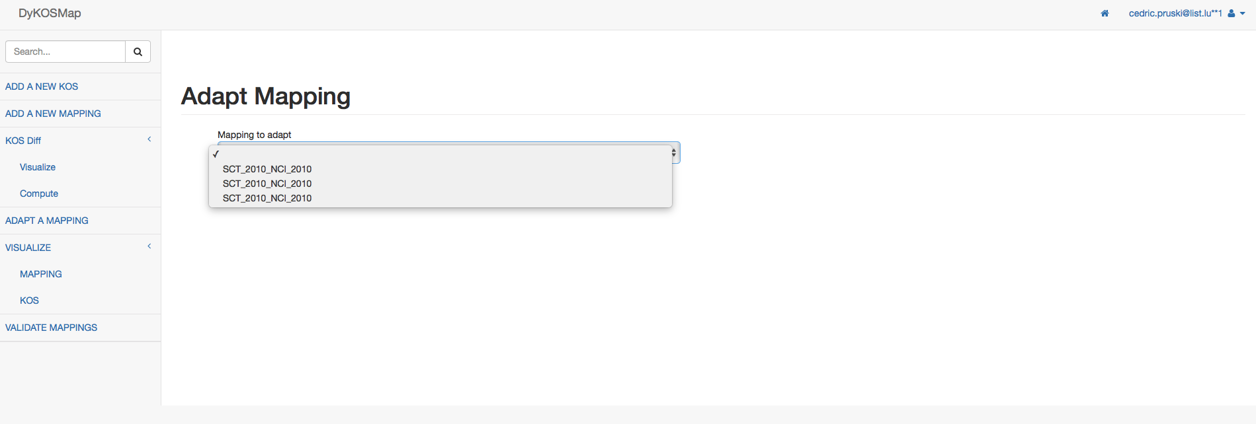
Adapt mapping

Slide 23
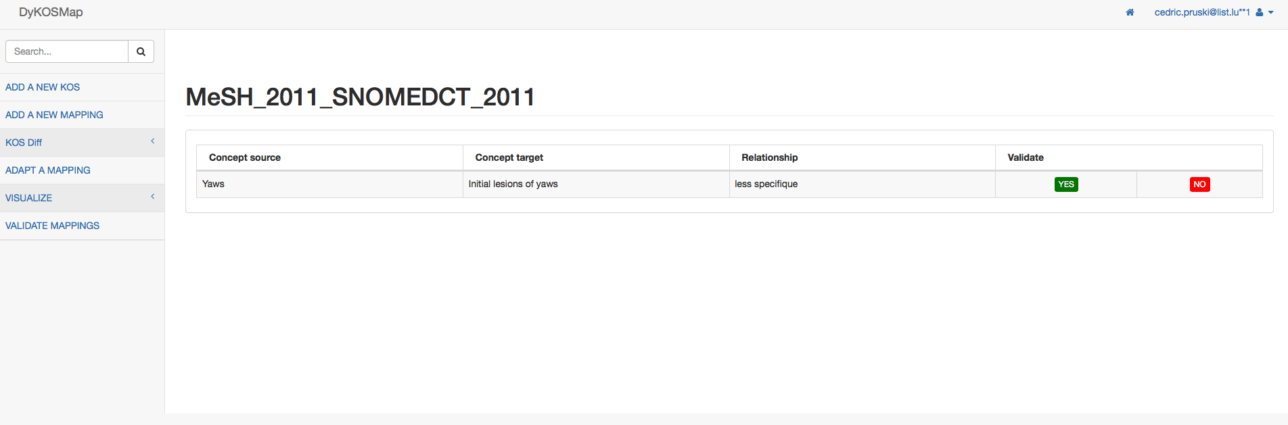
Validating mapping

Slide 24
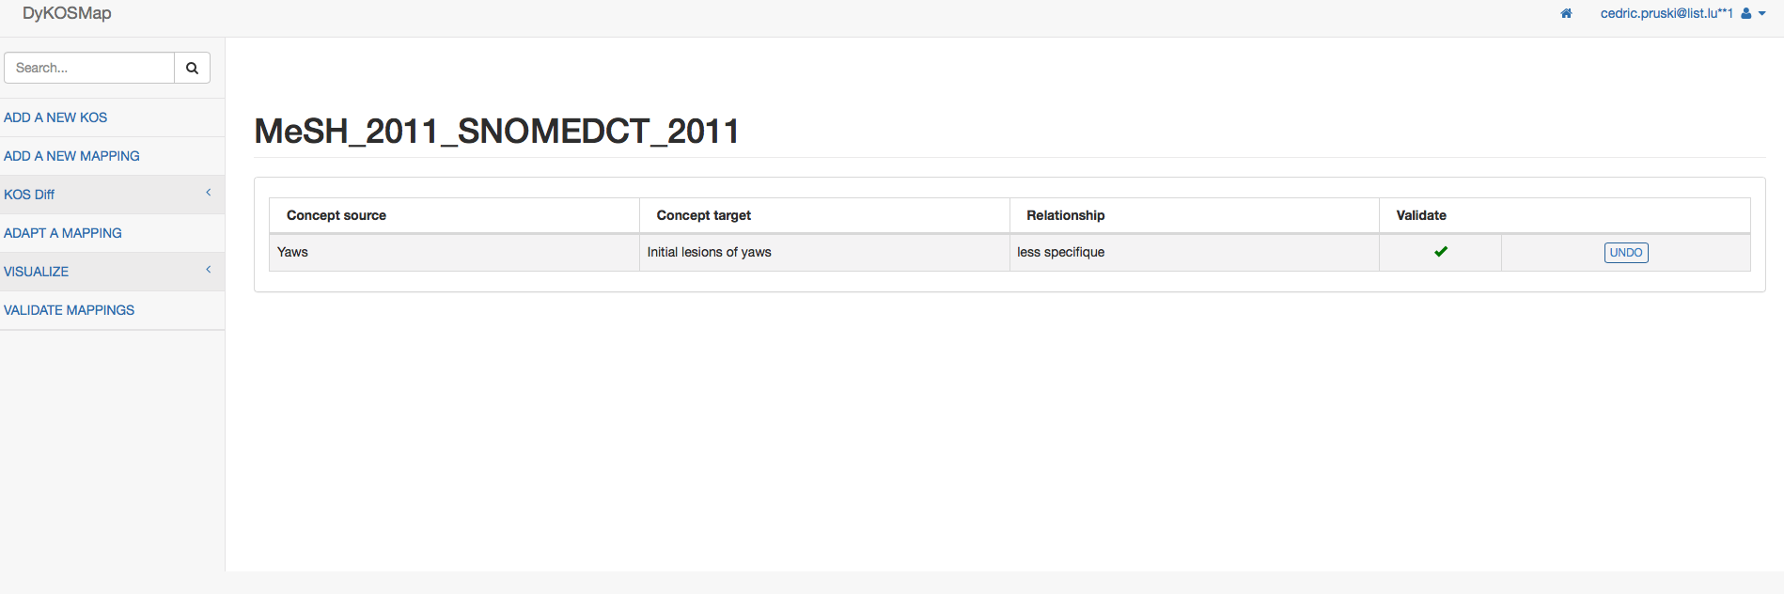
Validating mapping

Slide 25
conclusion
… and perspectives
DyKOSMap is a Web application for adapting ontology mappings impacted by the evolution of underlying ontologies
  Storage of ontologies and mappings
  Visualization
  Validation of mapping after adaptation
Perspectives:
  Improve the visualization module
    Large ontologies
    Dynamic ontologies and mappings
  Offer the corresponding RESTful web services
  Include a module to deal with evolution of semantic annotations

Slide 26
references
J. C. Dos Reis, C. Pruski, M. Da Silveira, C. Reynaud-Delaître, DyKOSMap: A framework for mapping adaptation between biomedical knowledge organization systems, Journal of Biomedical Informatics, 55, 153-173, (doi:10.1016/j.jbi.2015.04.001), 2015
M. Da Silveira, J. C. Dos Reis, C. Pruski, Management of Dynamic Biomedical Terminologies: Current Status and Future Challenges, IMIA Yearbook of Medical Informatics, 10(1), 125-133, 2015
D. Dinh, J. C. Dos Reis, C. Pruski, M. Da Silveira, C. Reynaud-Delaître, Identifying relevant concept attributes to support mapping maintenance under ontology evolution, Web Semantics: Science, Services and Agents on the World Wide Web, 29(0), 53-66, Life Science and e-Science, (DOI: 10.1016/j.websem.2014.05.002), 2014
J. C. Dos Reis, C. Pruski, M. Da Silveira, C. Reynaud-Delaître, Understanding semantic mapping evolution by observing changes in biomedical ontologies, Journal of Biomedical Informatics, 47, 71-82, 2014.
M. Hartung, A. Gross, E. Rahm, COnto-Diff : Generation of Complex Evolution Mappings for Life Science Ontologies, Journal of Biomedical Informatics 46(1): 15-32, 2013
J.C. Dos Reis, D. Dinh, C. Pruski, M. Da Silveira, C. Reynaud-Delaître, Mapping Adaptation Actions for the Automatic Reconciliation of Dynamic Ontologies, ACM International Conference on Information and Knowledge Management (CIKM 2013), San Francisco, CA (USA), 2013

Slide 27

Questions
Cedric.pruski@list.lu
www.elisa-project.lu

