Slide 1
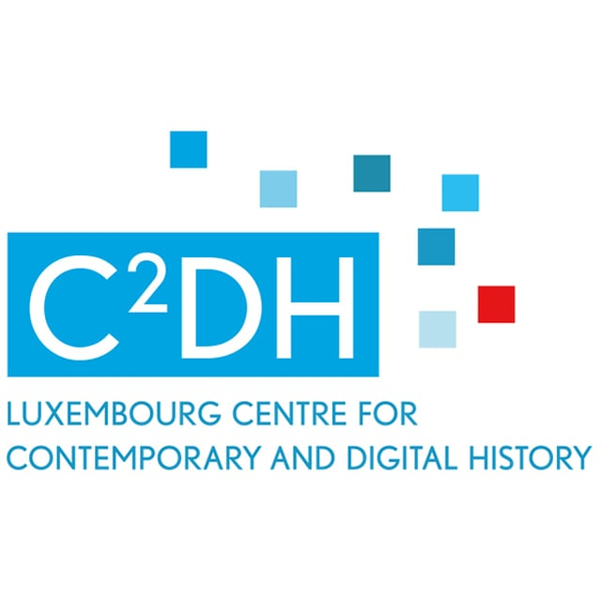
BLIZAAR: VISUALIZATION OF MULTILAYER NETWORKS
Dr. Fintan McGee
Dr. Marten Düring
Dr. Mohammad Ghoniem (PI Lux)
Dr. Fintan McGee
Dr. Marten Düring
Mikaël Stefas
Dr Simone Zorzan
Dr. Bruno Pinaud (PI F)
Prof. Guy Melançon
Dr. Sebastien Rufiange
Dr. Stefan Bornhofen
Dr. Maria Malek
Joachim Yerusalemi
Antoine Laumond
HyBrid VisuaLIZation of DynAmic MultilAyer GRaphs
This work was (partially) funded by the ANR grant BLIZAAR ANR-15-CE23-0002-01 and the FNR grant BLIZAAR INTER/ANR/14/9909176.
1

Slide 2
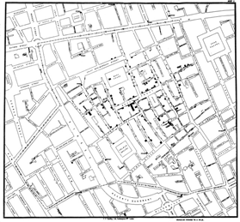
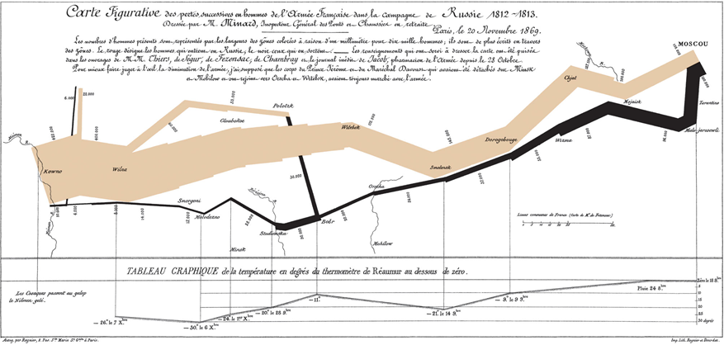
Visual analytics as a concept
Visualisation is often explanatory
John Snow’s Cholera outbreak map (1854 epidemic)
Minard's 1869 visualization of Napoleon's march on moscow
Exploratory Visualization
Explore the data set not just report results.
Visualization as a tool and not just an output
E.g. Distance Reading
Fingerprint matrices
Notes:
Public Domain image taken from Wikipedia
https://en.wikipedia.org/wiki/John_Snow#/media/File:Snow-cholera-map-1.jpg
Oelke, D., Kokkinakis, D., & Keim

Slide 3
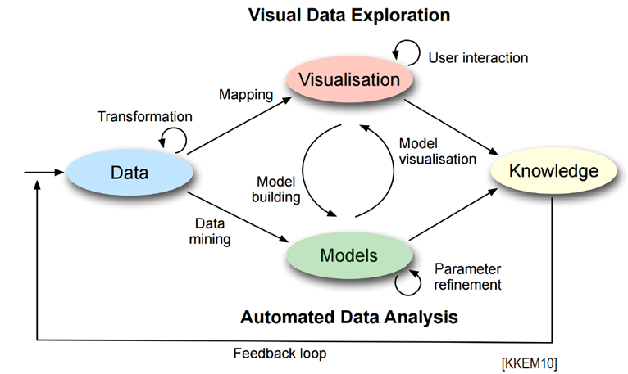
Visual analytics as a concept
D. A. Keim, J. Kohlhammer, G. Ellis, F. Mansmann, and D. Keim, Mastering the Information Age: Solving Problems with Visual Analytics. Goslar: Florian Mansmann and Eurographics Association, 2010.
Notes:
Technology has come a long way since 19th century
1998 Card, Mackinlay, and Shneiderman described visualization as
"the use of computer-supported, interactive visual representations of data to amplify cognition.”
Since then analyses and statistics have been further integrated and resulted in area of visualization: Visual Analytics
“Visual analytics combines automated analysis techniques with interactive visualizations for an effective understanding, reasoning and decision making on the basis of very large and complex data sets”
•Keim et al.2008

Slide 4
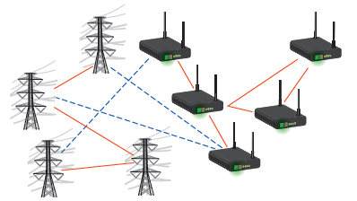
Why Multilayer Networks?
Network visual analytics traditionally sees a network as a complete and independent system
Complex systems can be more accurately modelled as a set of interacting networks (or layers)
Consider online social networks
The real social network of a person can be best modelled as a combination of the personal (e.g. Facebook) and professional (e.g. LinkedIn)
Connectivity between apparently independent network sets
Cross layer interactions
Unforeseen correlations
Power grid and data networks
Why not visualize as a single network?
Complexity : Overdrawing and clutter
make it difficult to recognise patterns
Task: Does drawing everything together
really help the user?
Notes:
The social networks will overlap ,but also have distinct members, changes in one network may cascade and cause changes in another

Slide 5
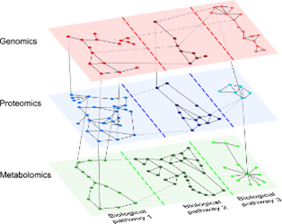
Multilayer Network Data
Many systems modelled as networks / Graphs
Transport networks, the power grid, computer networks, social networks
Multilayer Network data
Multiple interrelated data sets
Relationships between data set
Layers
Maybe same nodes, but not always
Maybe different types of edges
Some relationships might be
restricted to end node types
Layers can extend into different aspects
Visual Analytics of multilayer data is a relatively new field
Kivelä, Mikko, et al. "Multilayer networks." Journal of complex networks 2.3 (2014): 203-271.
5
Notes:
5

Slide 6
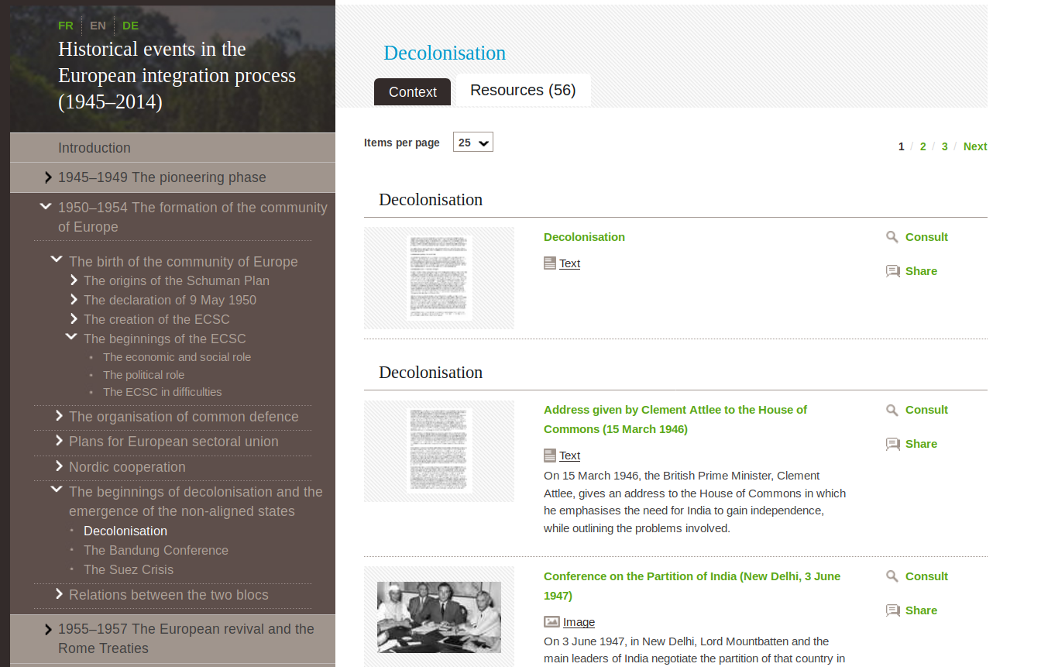
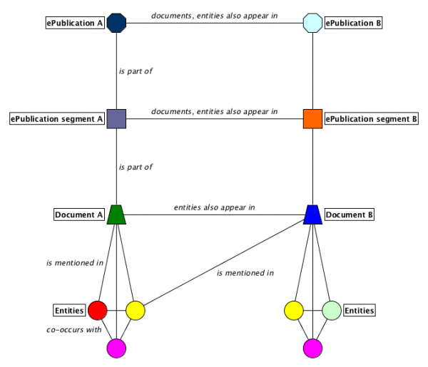
DH use case: Histograph dataset based on cvce.eu
The corpus is highly heterogeneous, contains gaps and biases.
Users do not have advanced skills in data analysis.
BLIZAAR therefore focuses on corpus exploration and content discovery.
Documents: ca. 18.000
Nodes: ca. 150.000
Edges: ca. 1 Million

Slide 7
DH use case: User stories
(1) Content overview
I would like to have an overview of how a specific person/institution/location is represented in the corpus and of the other entities with whom they are mentioned. This helps me to decide which documents I want to study in greater detail.
(2) Query knowledge expansion
I am interested in a topic but simple keywords are not suitable to retrieve relevant documents. Starting with my limited knowledge of the topic I want to receive suggestions for promising contents and additional keywords which can guide my exploration.

Slide 8
DH use case: User stories
(3) Explore search results
I am interested in a broader topic but am overwhelmed by the very large number of diverse search results. I want to be able to dissect and organize these results and understand how they are related to each other and their attribute values.
(4) Entity comparison
I want to compare specific entities (persons, institutions, locations, but also collections) in the corpus so as to get a better understanding of their presence in the corpus. I want to study how the contexts (entities) in which they appear change over time. I want to explore links between the entities I compare.

Slide 9
Biology use case
The classic multilayer networks use case
‘omics Layers (Proteomics, metabolomics, genomics)
Each layer can be analysed individually
All part of the same system
But they interact
Proteins may interact with metabolites as enzymes
Proteins play a role in genomics (interaction with RNA/DNA)
...
Other layer divisions
Biological pathway, species, time...
Vast amounts of data produced by decades of experiments
And classification data
10s of millions of relationships in a biological database
…. Where to start?

Slide 10
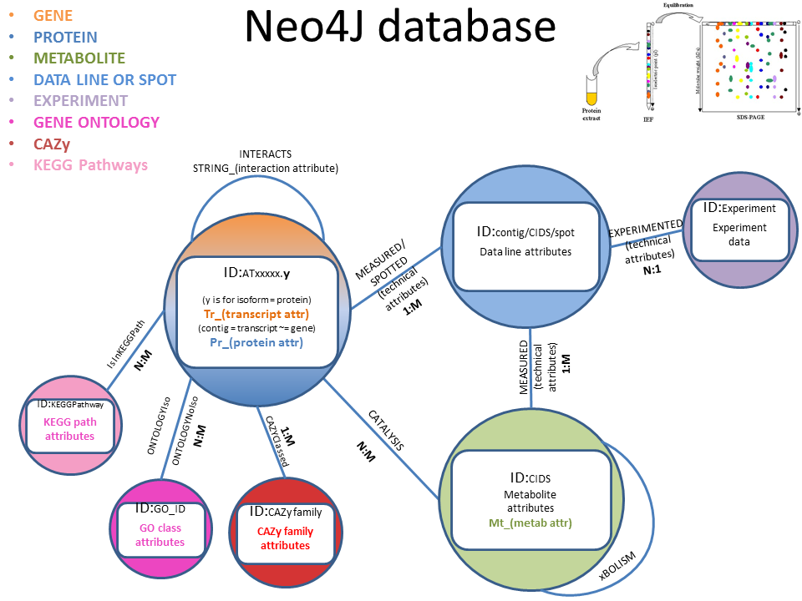
Biological Data
Notes:
356,992 nodes
46,481,534 Edges (without Kegg)
Contains data form multiple online data bases … stitich ( metab) string and kegg, Gene ontology

Slide 11
Biology use case: User stories
(1) Content overview
I am interested in a specific protein / metabolite / Gene /experiment. I would like an overview of the related entities and I need to restrict the results based on the strength of relationships between entities. This helps me to decide which entities I want to analyse in greater detail.
(2) Query knowledge expansion
I am interested in a specific set of genes, metabolites and proteins. I would like to find items related to this set without being overloaded by data. Once I have found an item of interest, I would like to add its related neighbours to better understand the data. I would like to understand the relationship between two selected entities.

Slide 12
Biology use case: User stories
(3) Explore search results
I am interested in a set of entities but am overwhelmed by the very large number of of data returned I want to be able to dissect and organize these results and understand how they are related to each other and their attribute values.
(4) Entity comparison
I want to compare different layers (proteins /genes/ Metabolites) and better understand the interactions at each layer. I want the understand the attribute values associated with each entity.

Slide 13
Design Considerations of BLIZAAR
Web based platform
Easily accessible for many users
Easy to control use access rights
Powerful existing technologies / frameworks ( Angular, D3, node.js …)
Discrete components, allowing full use to be made of existing libraries / functionality
Access to large databases
Built in large complex networks of domain data sets
Histograph
Biological datasets ( STRING, STITCH, Kegg)
Cross domain applicability
Base components can be reused together to provide functionality for specific domains
Hybrid visualizations
Complex structure of multilayer networks may require novel visualization

Slide 14
Use Case 1: Content Overview
Large Master datasets
Need to define the nodes of interest for our Multilayer Network
User can select a starting node of interest and bring in all nodes related across predefined layers for their use-case
For the biology use case the quantity of edges makes this difficult
Filter on edge attributes
Select experiment data set to bring in all related nodes
We can examine the structure internal to a layer and compare it to the content of other layers. Node selection is across all layers. We can cluster layers to see if there are any patterns of interest.
We can examine specifically the connectivity between layers
DOI:

Slide 15
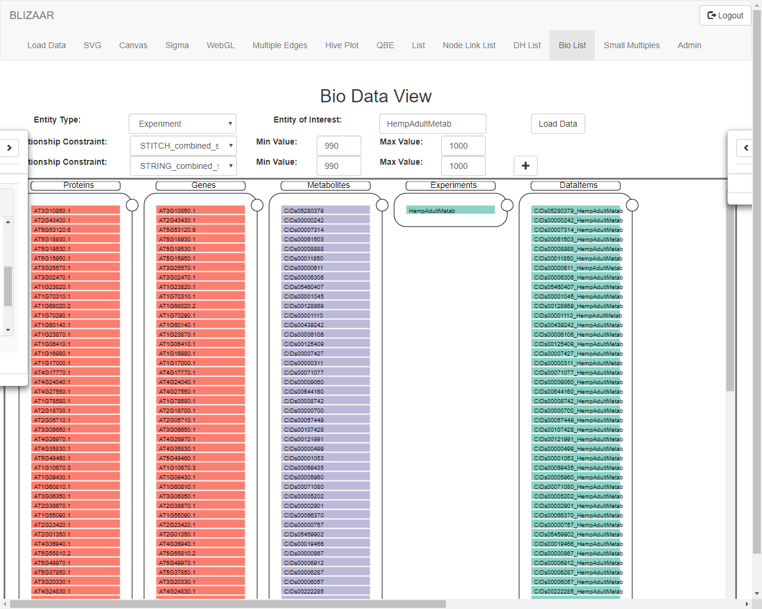

Slide 16
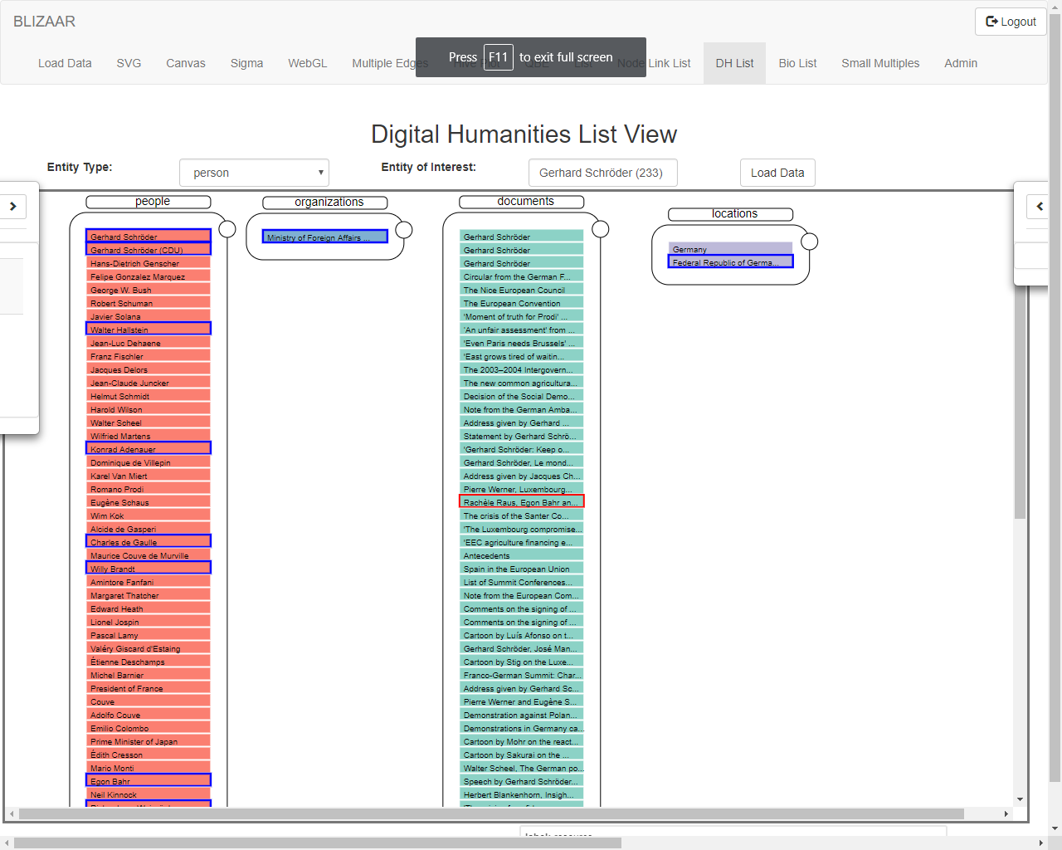
Building and ego network
Notes:
Here is the ego network of gerhard schroder, all documents, organizations, location and people related to him. Connections between layers can be very dense, so here we just hightlig the neighbours of the selected node in red

Slide 17
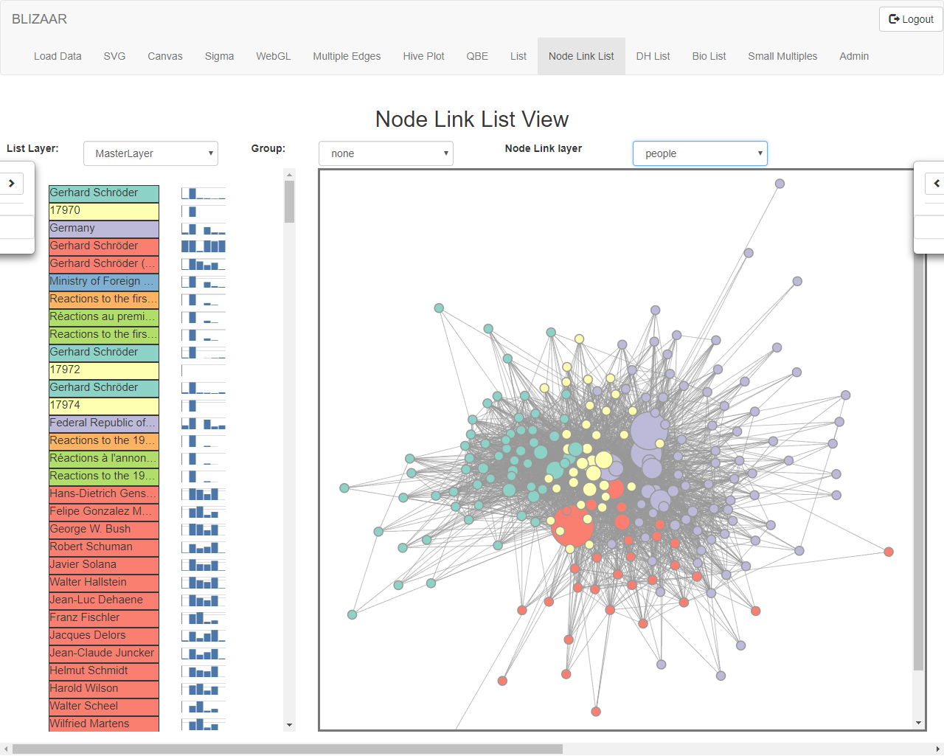
Notes:
We can examine the structure internal to a layer and compare it to the content of other layers. Node selection is across all layers. We can cluster layers to see if there are any patterns of interest. IN this paricular case we have run a clustering algorithm, to identify communities

Slide 18
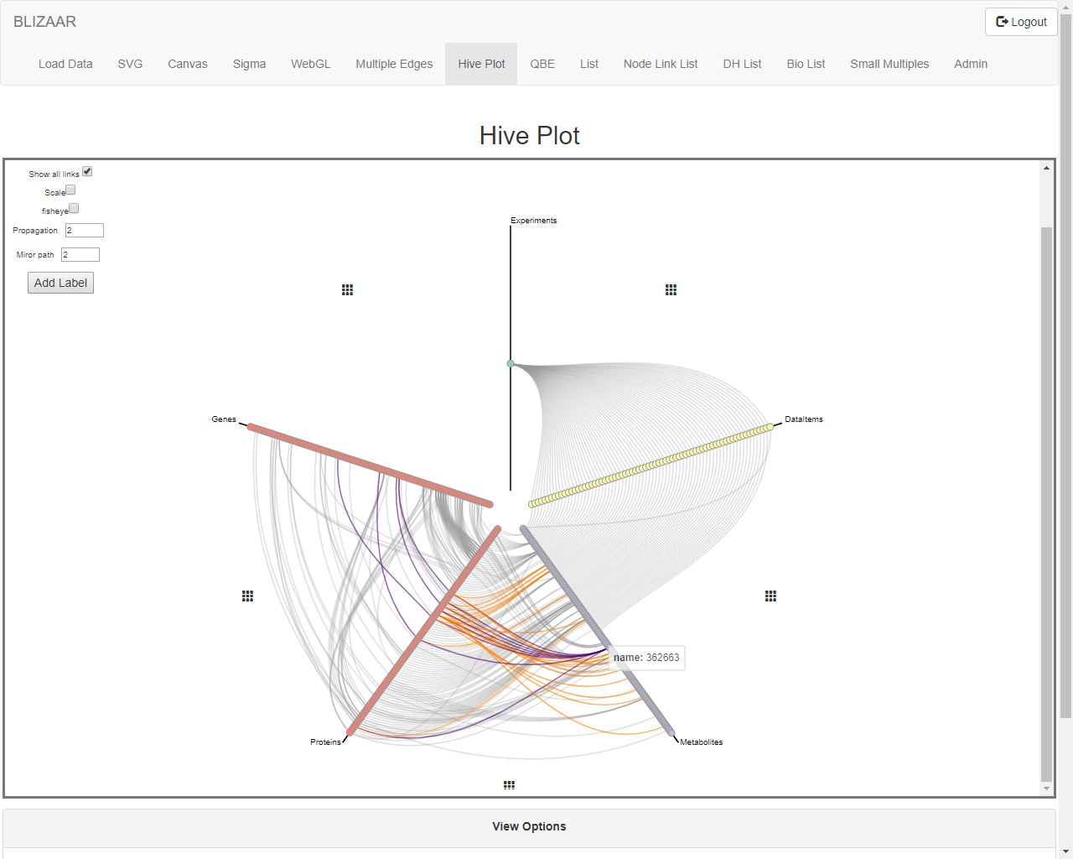
Experiments
Genes
Experiment data items
Proteins
Metabolites
Notes:
Bio Use Case
We can highlight individual nodes and see how their connections propagate across layers , a nd refelct back in to the laye of the highlighted node

Slide 19
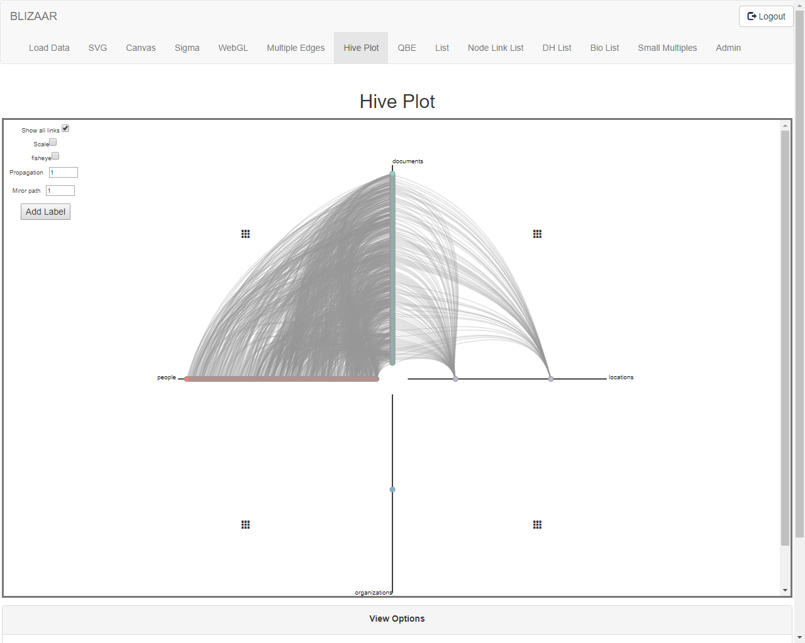
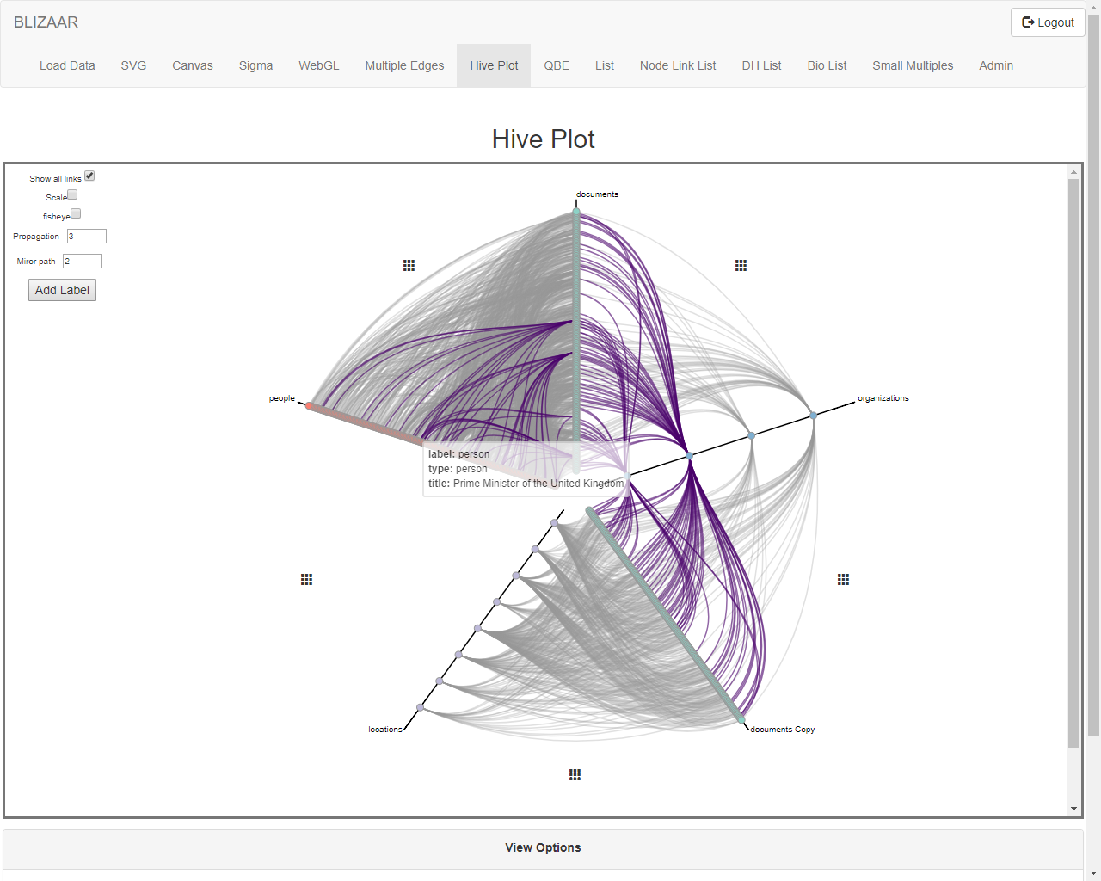
Documents
Organizations
People
Locations
Documents (copy)
Notes:
We can also view the connection between layers for the DH data set.

Slide 20
Use Case 2: query expansion
Sometimes a starting point of a single node query is not suitable for the users needs.
DOI (Degree of Interest) functionality
The user selects nodes of interest
The system pulls back new nodes based on this selection
As more nodes of interested are added, the network is continuously updated
Node Expansion
Start with a single node as before
Click on a node to query the backend database for its neighbours.

Slide 21
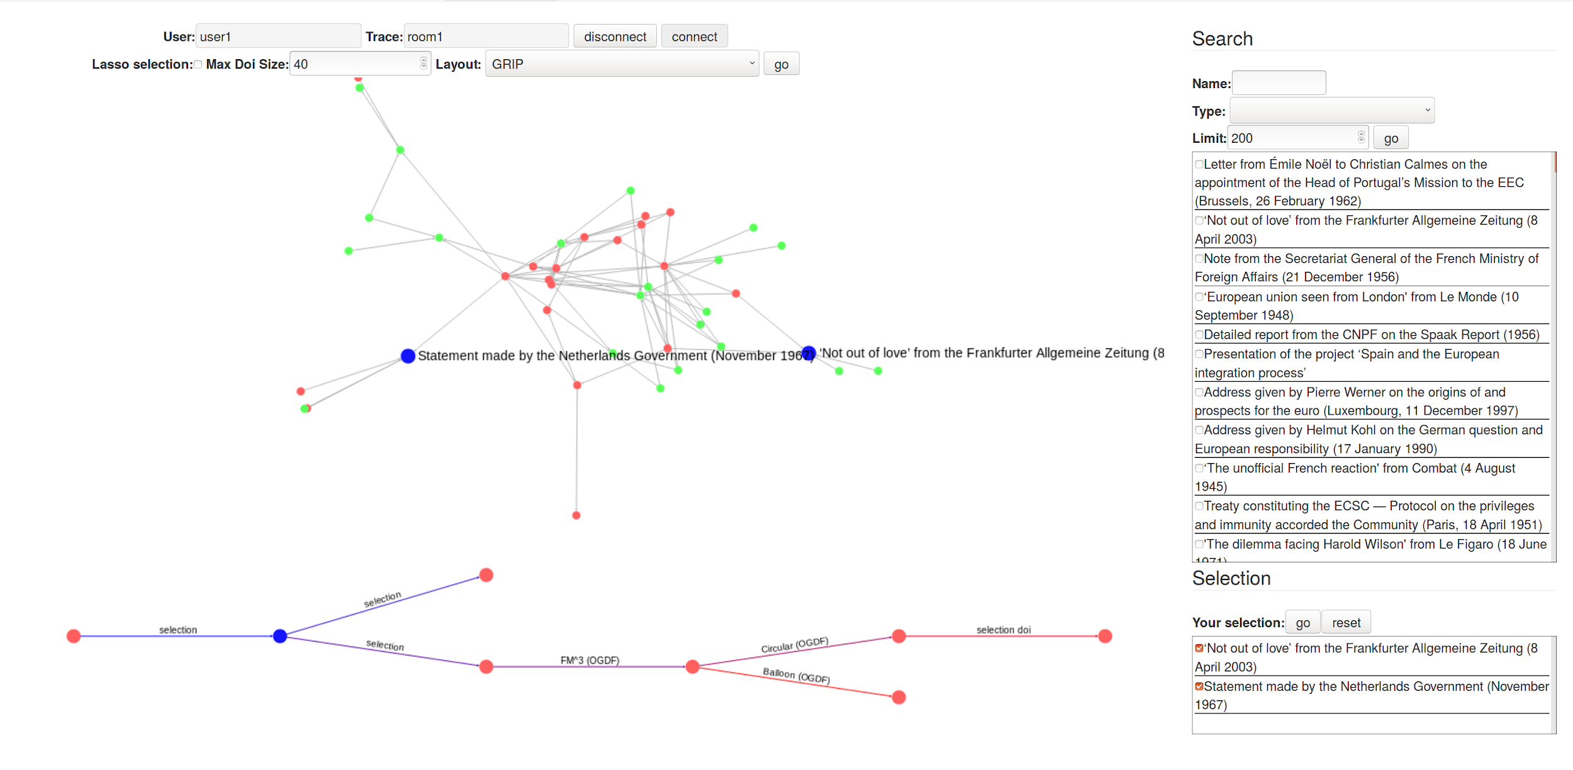
DOI
Notes:
DOI (Degree of Interest) functionality
The user selects nodes of interest
The system pulls back new nodes based on this selection
As more nodes of interested are added, the network is continuously updated
We keep track of the hierarchy of operations

Slide 22
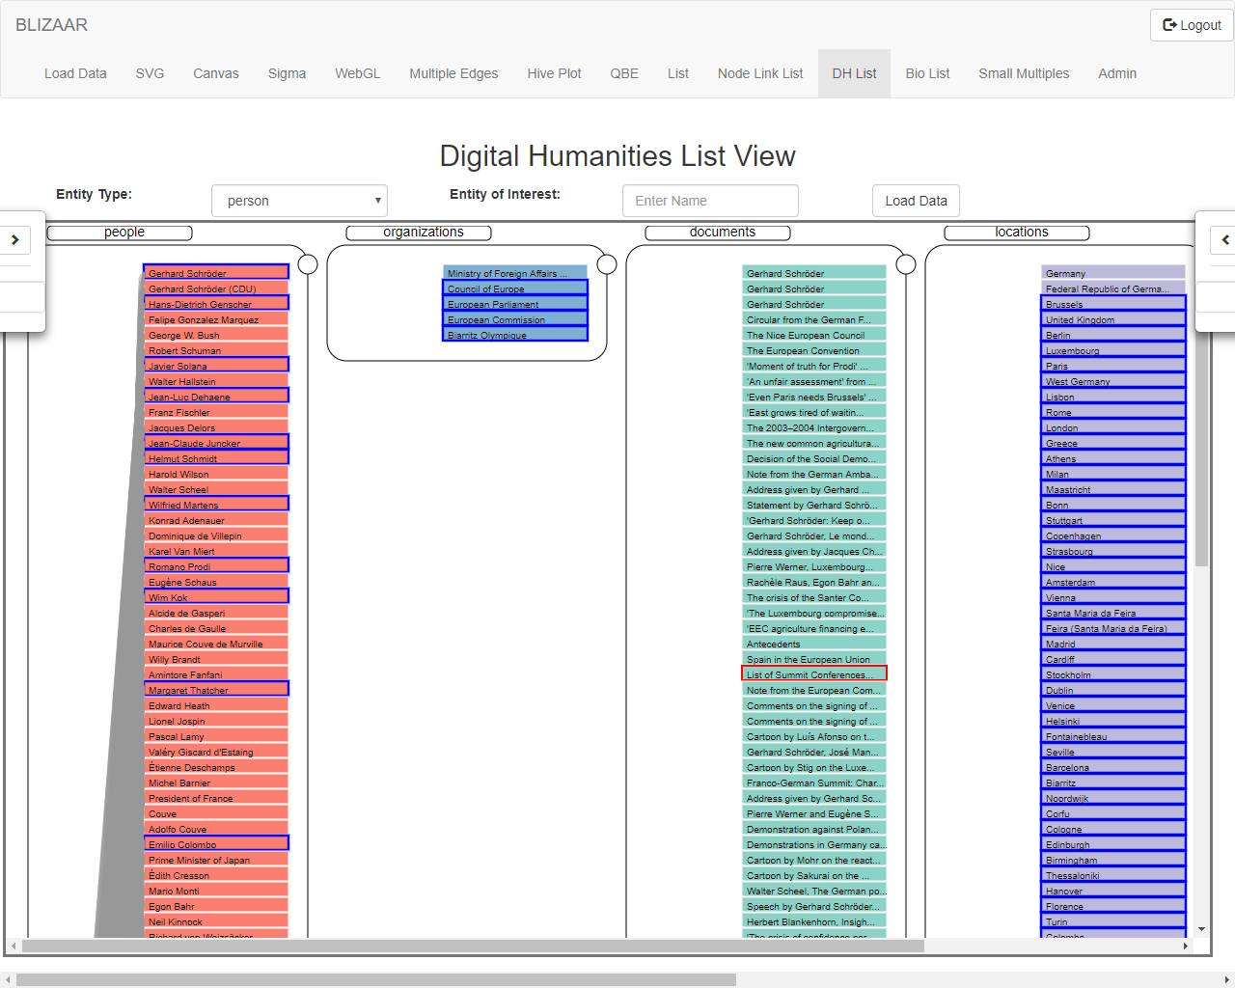
Notes:
Nodes can also be expanded in the list view , pulling in more data from the back end database. In this case (Digital Humanities), the document describing the list of summit conferences has been expanded to bring in more nodes ( primarily locations and organizations) to the Network

Slide 23
Use Case 3: Explore search results
Analyse Attributes
The individual attributes of the nodes can be charted to find outliers, see distributions etc.
Nodes can be scaled by Attribute Values: big node => big number
Clustering within layers : These elements belong together….
Explore the connectivity between layers
Dense edges are difficult to read
Draw as matrices and cluster to make edge connectivity patterns more visible)
Divide layers into Matrix and Node Link Visualizations
Depending on the local network contents, to clarify dense areas within a layer

Slide 24
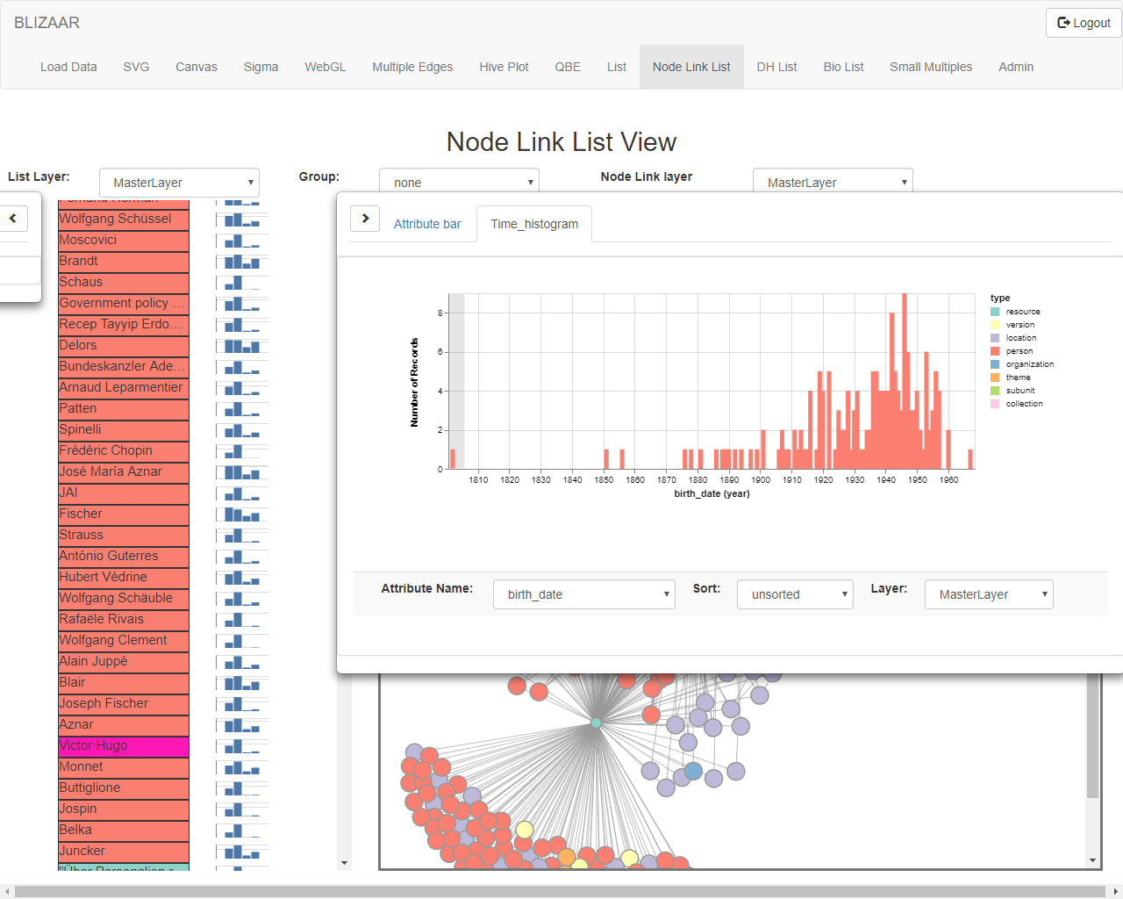
Notes:
We can analyses the distribution of attributes ( in this case birth data of people). We select the outlier and can see in the main view that it is “Victor Hugo”.It is highlighted acorss all views of the grpah

Slide 25
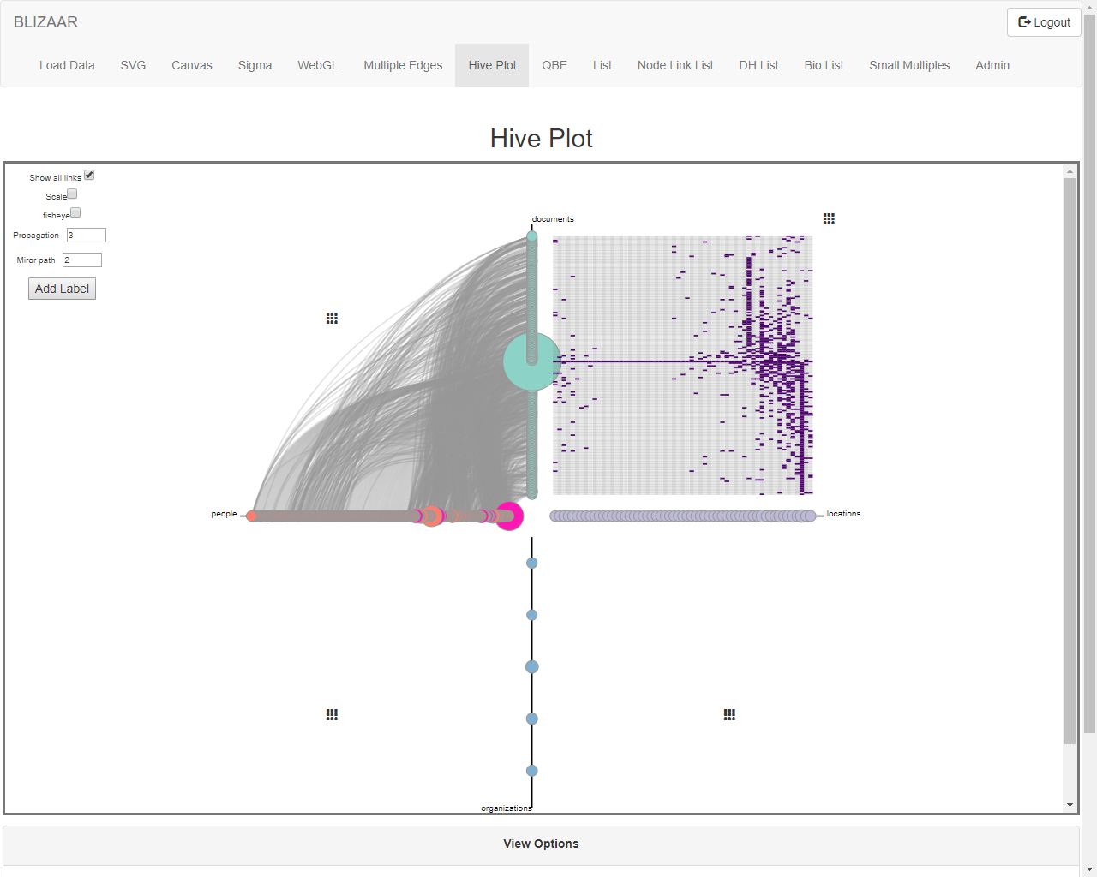
Notes:
We can examine the structure of the connectivity between the document and location layers. As the regular edges become overdrawn and difficult to discern , we use a matrix to show the connections.
NB there are tool tip which are not shcown in the screenshot.

Slide 26
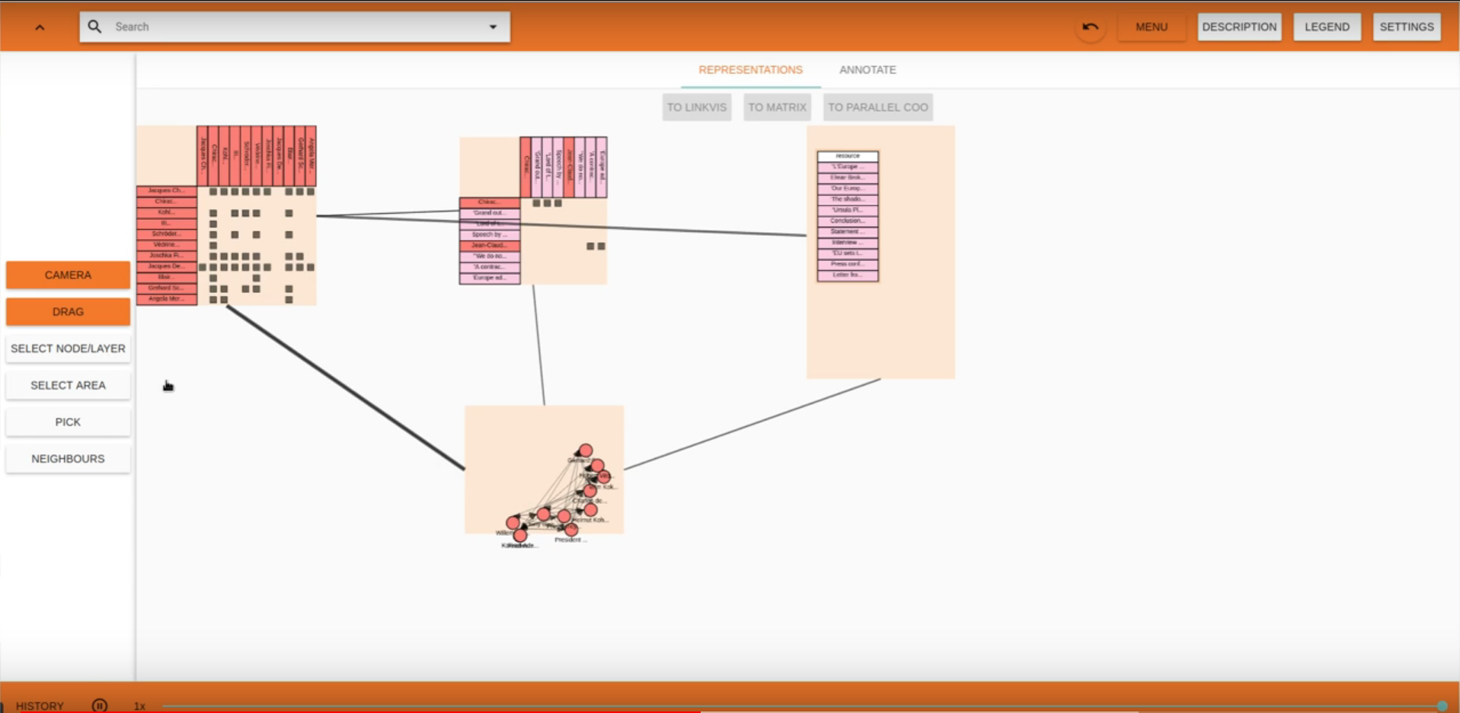
Notes:
Divide layers into Matrix and Node Link Visualization
Depending on the local network contents, to clarify dense areas within a layer

Slide 27
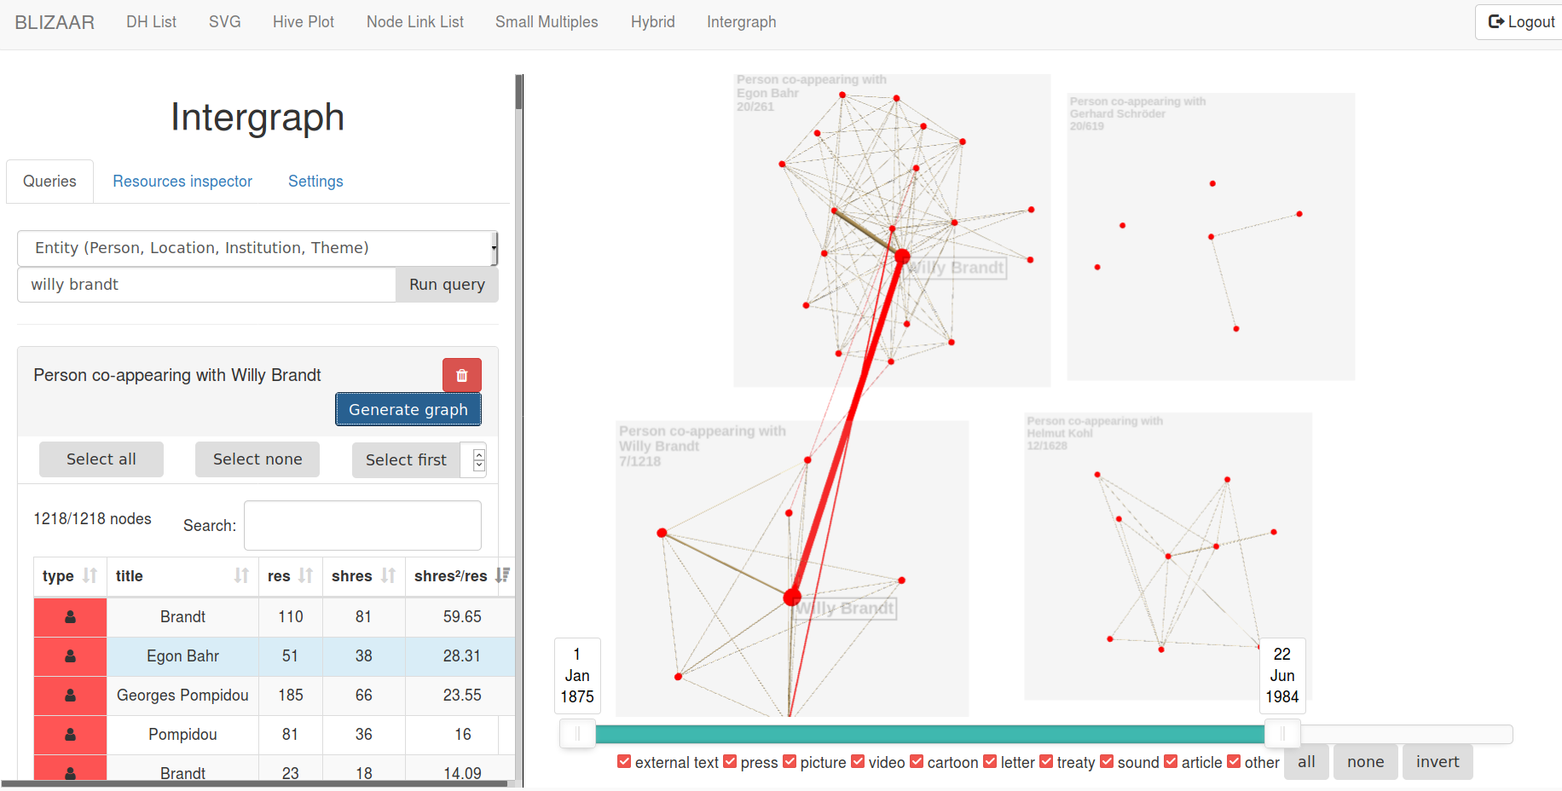
Use Case 4: Entity comparison
A key concept of the multilayer paradigm is to be able to compare layers
Notes:
Comparing Ego Networks, examining how they change over time and where the overlaps are

Slide 28
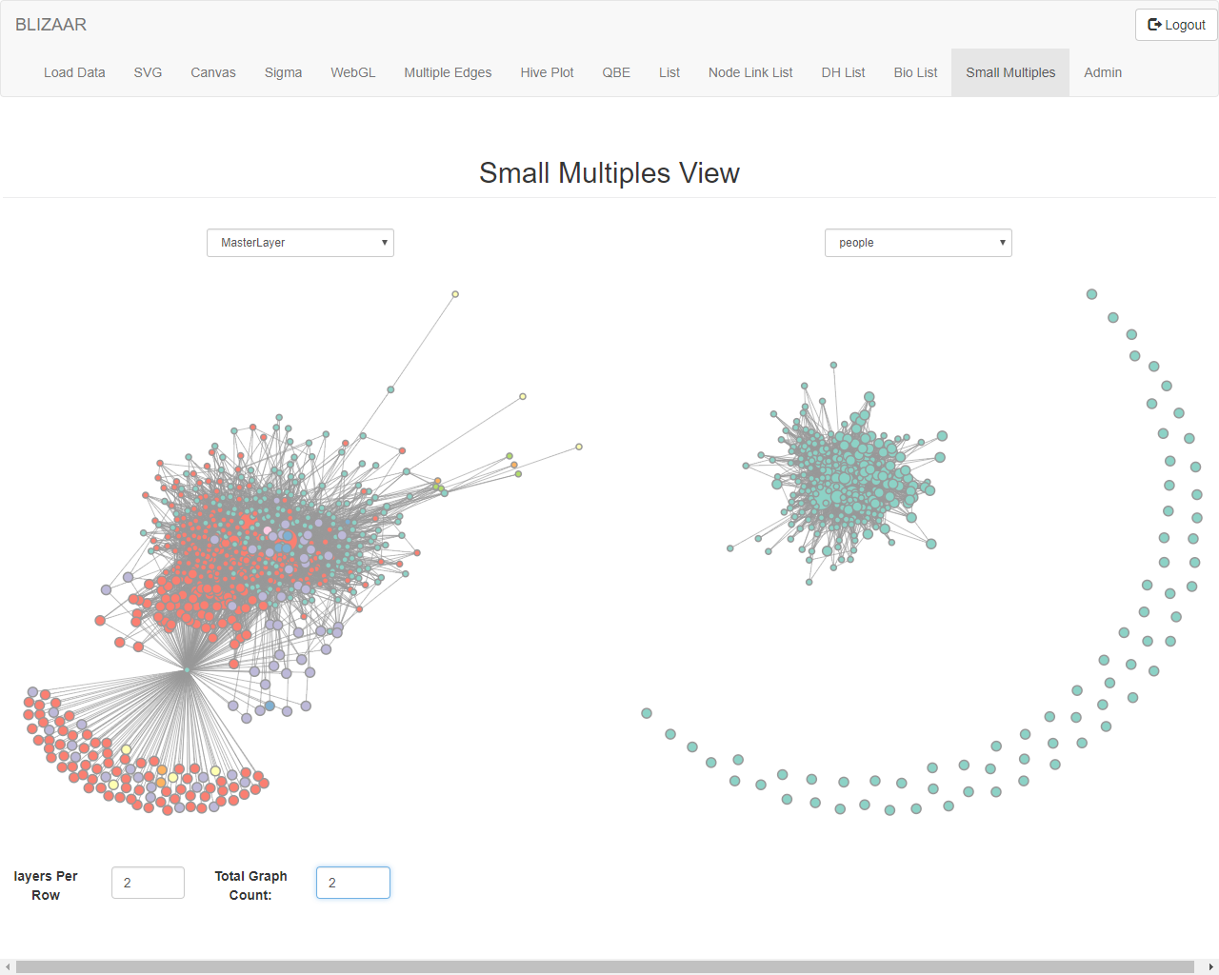
Layer Comparison
Notes:
Comparison of internal structure across layers

Slide 29
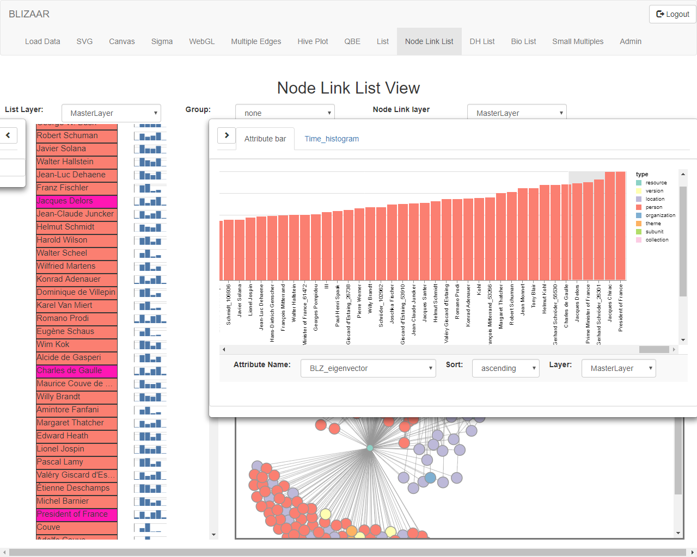
Notes:
We calculate useful network Centralities and can use them to better understand the Network. In this case eigenvector centrality, a measure of how important a node and its neighbours are . This can be done for different layers

Slide 30
The End (ish)
Questions?

Slide 31
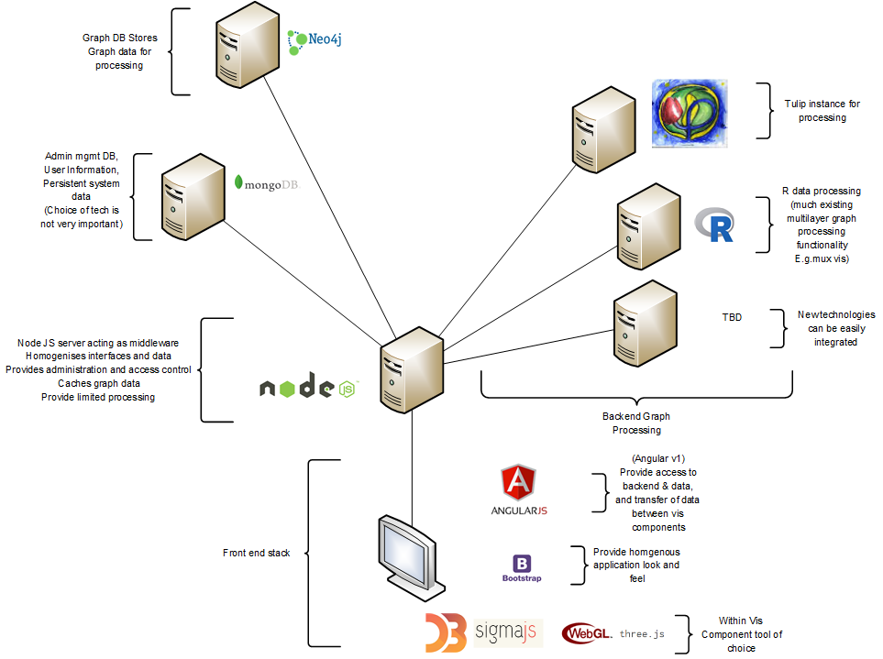
Architecture

